Slide 1
Epidemiological Modeling of COVID-19 Dynamics in California
Preliminary Results
NOT FOR DISTRIBUTION
March 19, 2020

Slide 2
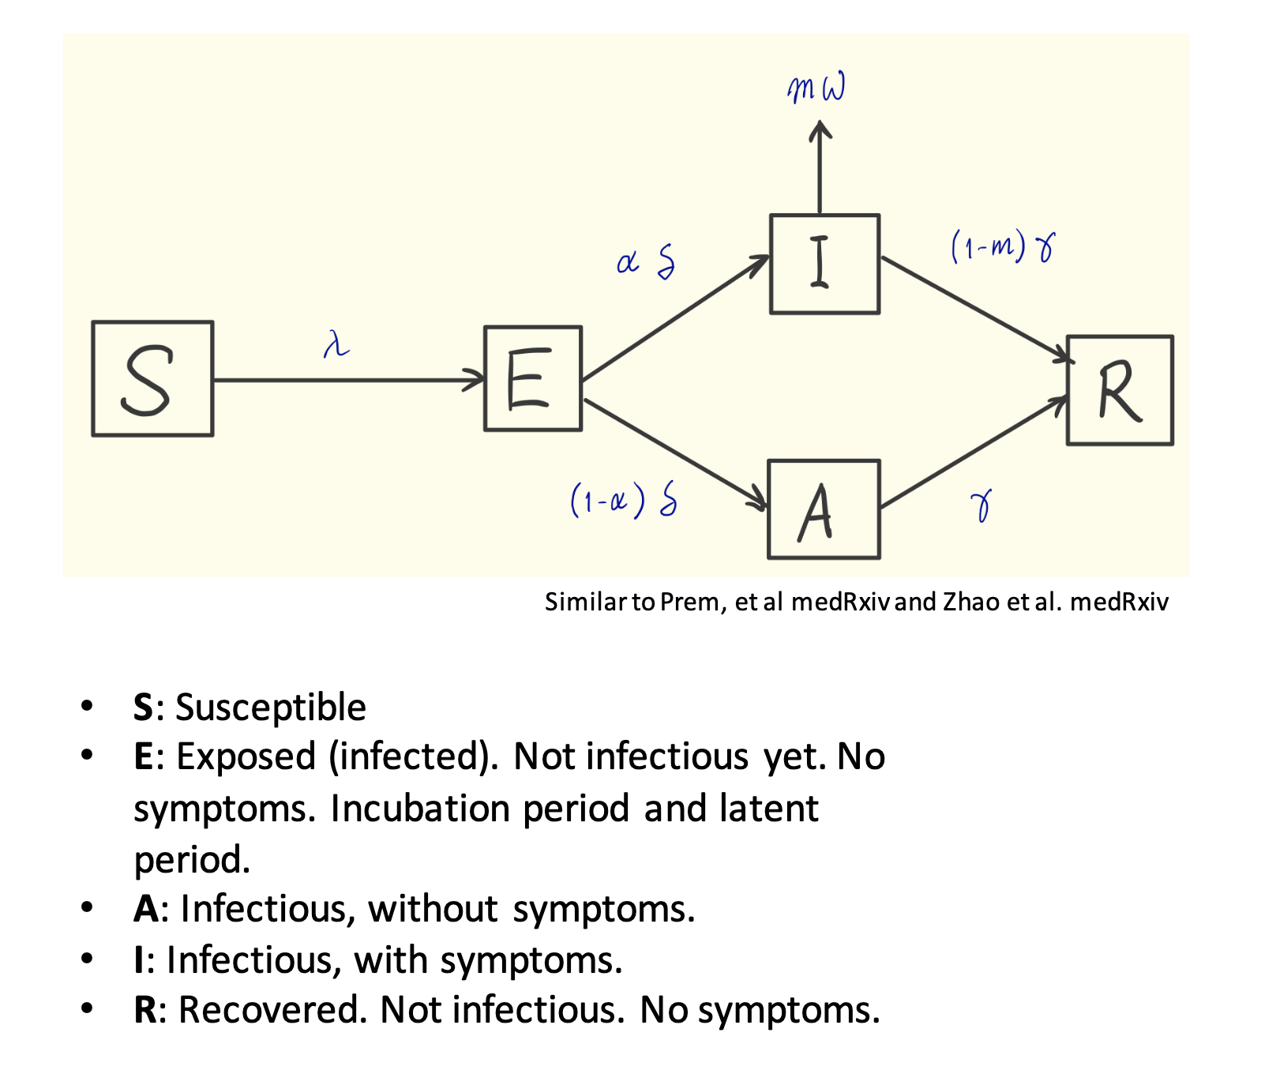
Model structure

Slide 3
Age stratification
Source: American Community Survey (2018)

Slide 4
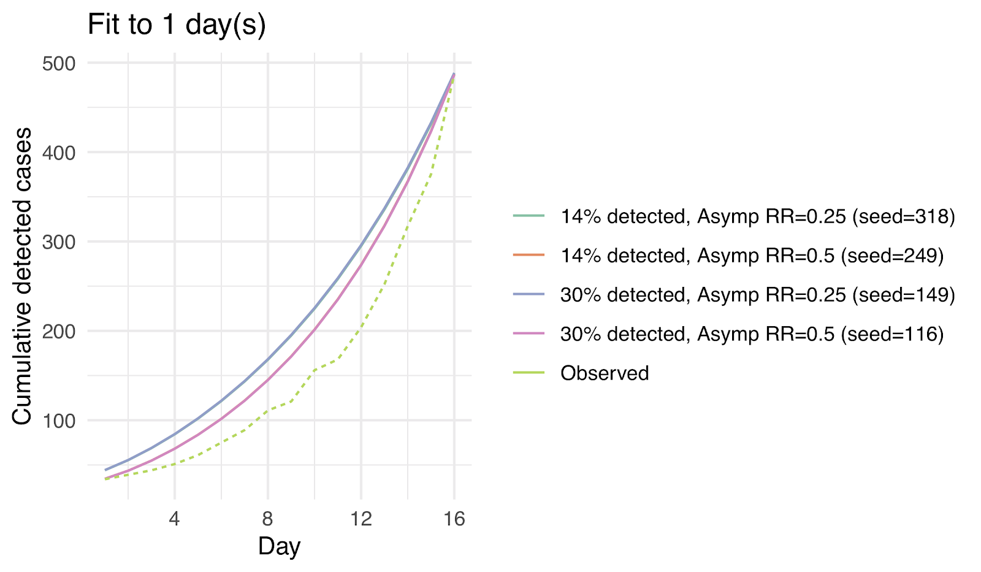
Preliminary results. NOT FOR DISTRIBUTION

Slide 5
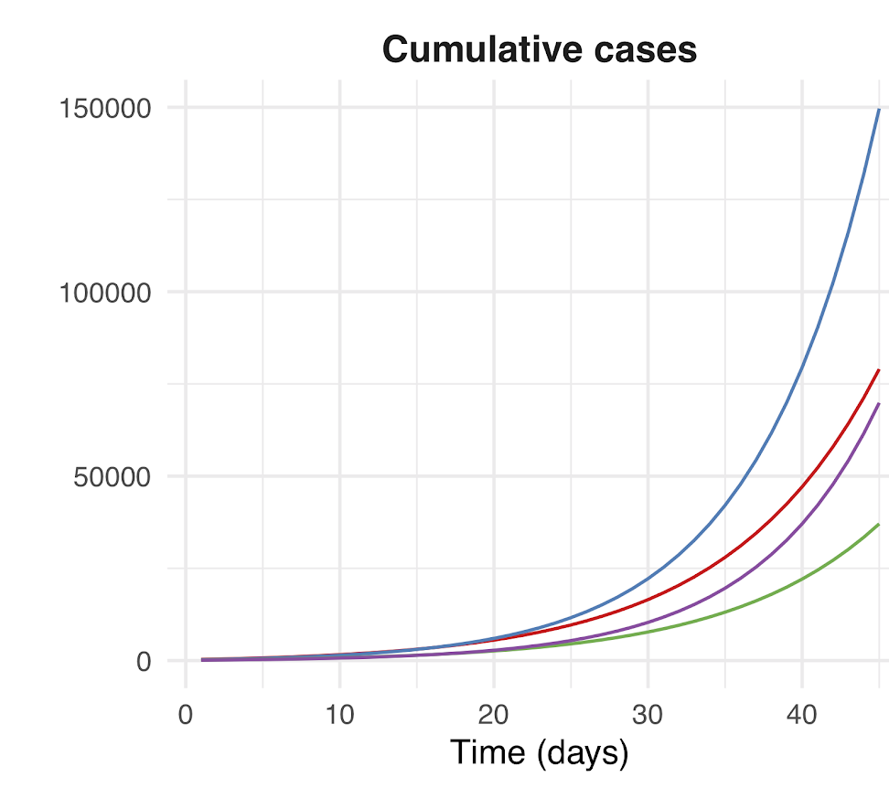
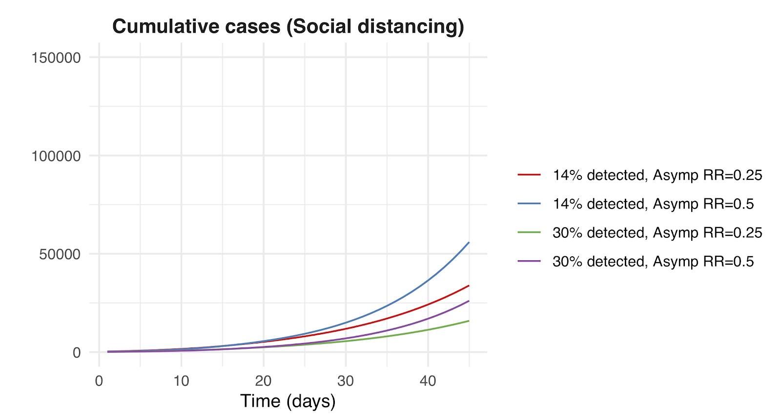
Preliminary results. NOT FOR DISTRIBUTION

Slide 6
Appendix

Slide 7
Epidemiological parameters
Description | Base case | Range
basic reproductive number (R₀) | 2.2 | (1.5, 3.2)
relative rate of asymptomatic transmission |  | 0.25 or 0.5
proportion of individuals < 20 that do not ever experience symptoms | 0.75 | (.5, .9)
proportion of individuals 20-64 that do not ever experience symptoms | 0.3 | (.2, .4)
proportion of individuals 65+ that do not ever experience symptoms | 0.3 | (.2, .4)
average length of pre-symptomatic infected period | 0.5
average length of incubation period | 5 days | (4-6)
average duration of infection | 5 days | (3-7)
case fatality rate (< 20) | 0
case fatality rate (20-64) | 0.005
case fatality rate (65+) | 0.1
percentage of cumulative cases observed at March 15 |  | 13% or 30%
number of cumulative cases observed at February 29 |  | calibrated
ratio of latent group to infected group at baseline | 1
relative testing rate of kids | 1
relative infectiousness of kids | 1 | (.5-1)
relative susceptibility of kids | 1 | (.5-1)

Slide 8
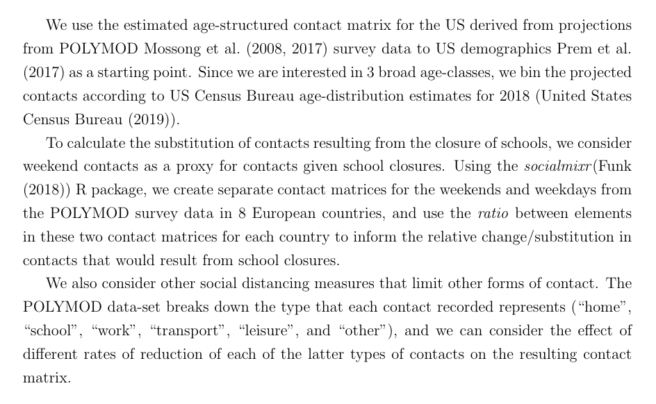
Contact rates by strata

